Slide 1

Implement a Centralized Log Management System Using ELK Stack

Slide 2
Our team Supervisor: Eng. Shihab Al-Batal
– Mohamed Hesham
– Khaled Mohamed
– Ziad Abbas
– Ebrahem Mohamed
– Mohamed Hassan

Slide 3
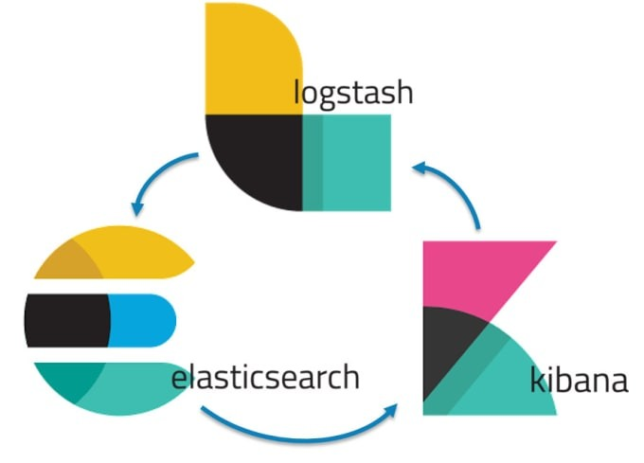
Project Overview
Problem Statement:
Modern IT environments generate massive, distributed logs
Need for centralized monitoring and security analysis
Solution: ELK Stack implementation
Key Benefits:
Real-time log analysis
Threat detection
Performance monitoring

Slide 4
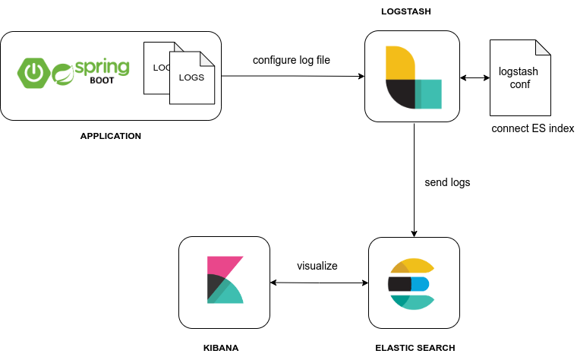
What is ELK Stack?
The ELK Stack stands for Elasticsearch, Logstash, and Kibana – a powerful open-source platform for log management and data analysis.
Elasticsearch: Search & analytics engine
Logstash: Collects & processes data
Kibana: Visualizes data through dashboards and charts
Beats (added later): Lightweight data shippers
Together, they form the Elastic Stack, enabling real-time log collection, search, and visualization across your infrastructure.
Use Cases: Monitoring, Troubleshooting, Business Intelligence, Security Analysis, Compliance.

Slide 5
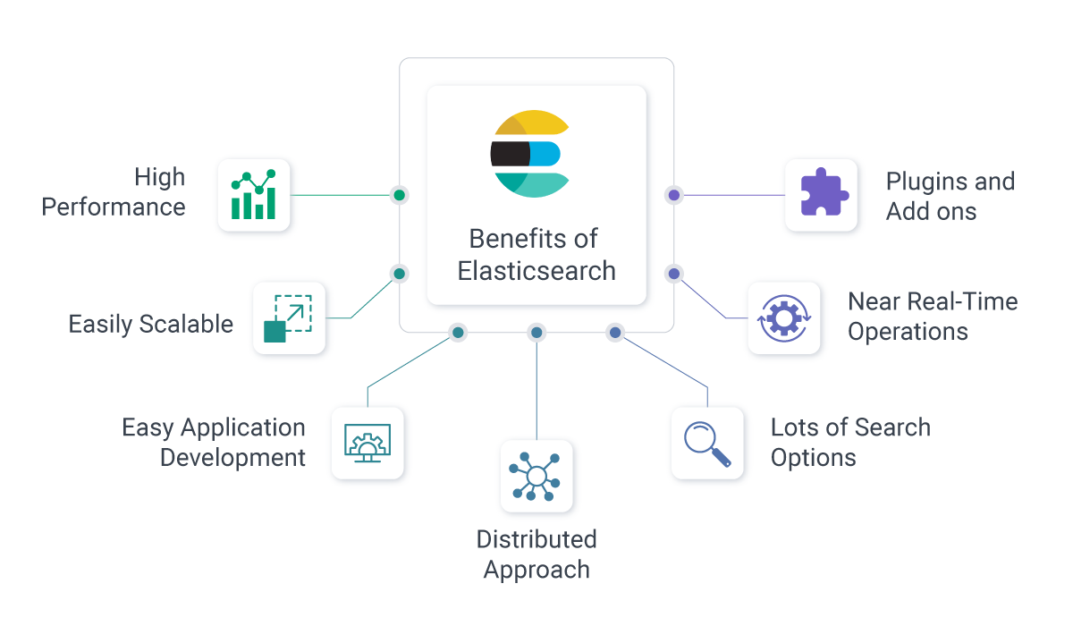
Elasticsearch
A distributed search and analytics engine built on Apache Lucene
Stores structured and unstructured data
Allows real-time search, filtering, and analysis
Uses RESTful APIs for interaction
Scales horizontally for big data environments

Slide 6
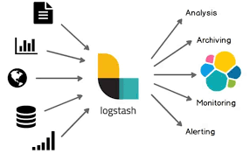
Logstash
A log and data processing pipeline
Collects data from various sources (e.g., logs, metrics, databases)
Parses, transforms, and enriches data
Sends processed data to Elasticsearch or other outputs
Highly flexible with plugins (inputs, filters, outputs)

Slide 7
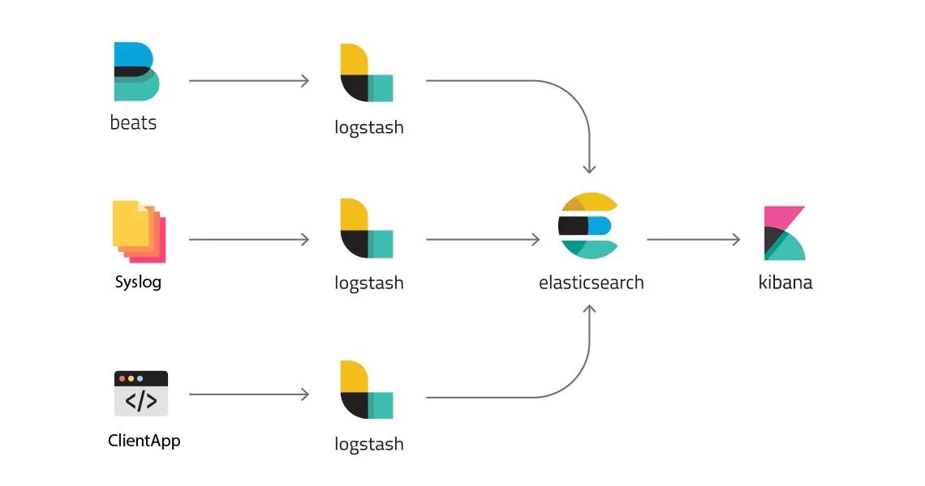
Kibana
The visualization layer of the stack
Connects to Elasticsearch to query and display data
Provides interactive dashboards, charts, and maps
Useful for monitoring, trend analysis, and reporting
Supports custom visualizations and alerts

Slide 8
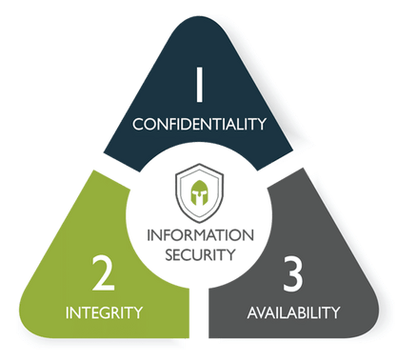
What is the CIA ?
🔐 Confidentiality
Ensures that sensitive information is accessible only to authorized users.
Example: Password protection, data encryption.
🧬 Integrity
Ensures the accuracy and trustworthiness of data.
Prevents unauthorized data modifications.
Example: Checksums, hashing.
🟢 Availability
Ensures that systems and data are available to users when needed.
Example: Uptime monitoring, backup systems.

Slide 9
How does ELK help protect the CIA?
✅ Confidentiality
Tracks and logs access to sensitive data.
Detects unauthorized access or suspicious behavior.
✅ Integrity
Monitors for unexpected changes in files, configurations, or systems.
Helps identify tampering or data corruption.
✅ Availability
Detects performance issues and failures early.
Sends alerts to prevent downtime and maintain service continuity.

Slide 10
System video
https://drive.google.com/file/d/1CEGBfrLeS25IrqS1BTOewJyEkD7CFhme/view?usp=drive_link

Slide 11

Thank You

